Slide 1
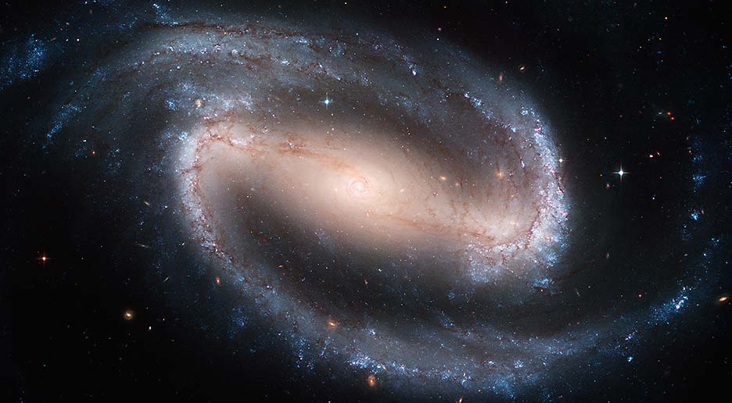
Observation of Discrete Oscillations in a Model-Independent Plot of Scale Factor vs. Lookback Time
Harry I. Ringermacher
and
Lawrence R. Mead
Dept. of Physics and Astronomy
U. Of Southern Mississippi
AAS 224, 6/2/2014, Boston

Slide 2
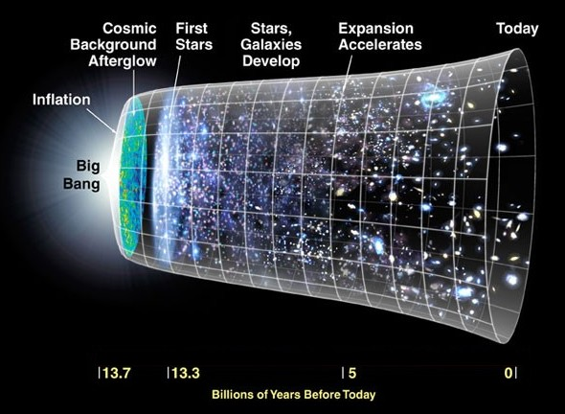
The ΛCDM Universe

Slide 3
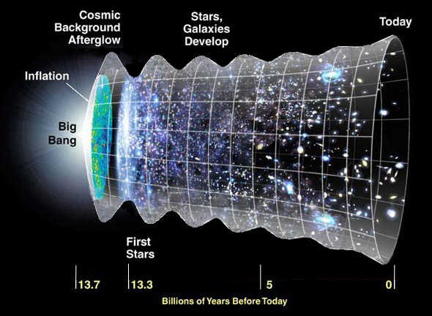
Is the Universe Ringing Down ?
- Dark matter density wave -

Slide 4
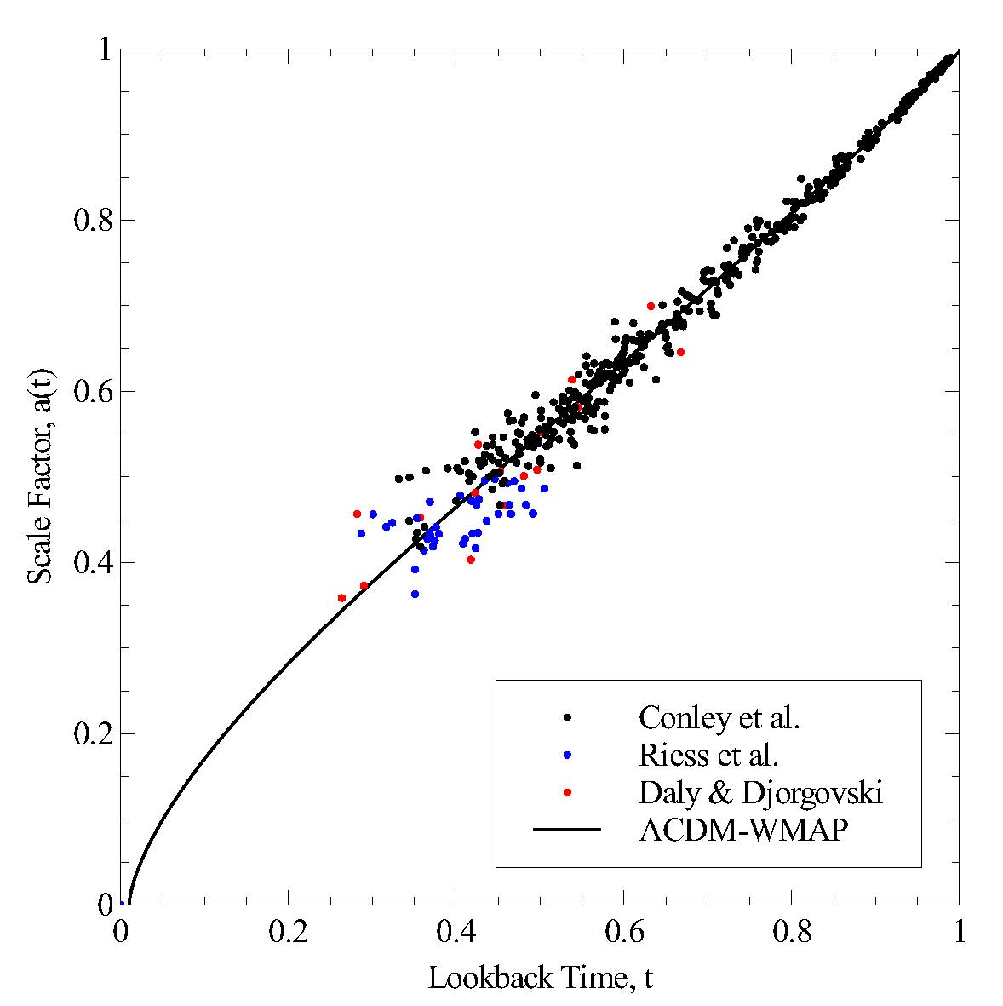
Scale Factor Plot
Using 2011 Conley et al. , 2004 Daly & Djorgovski, 2004 Riess et al.
Accepted
AJ, 2014
Transition-z @
ΛCDM inflection pt.
z = 0.77
t = 0.52

Slide 5
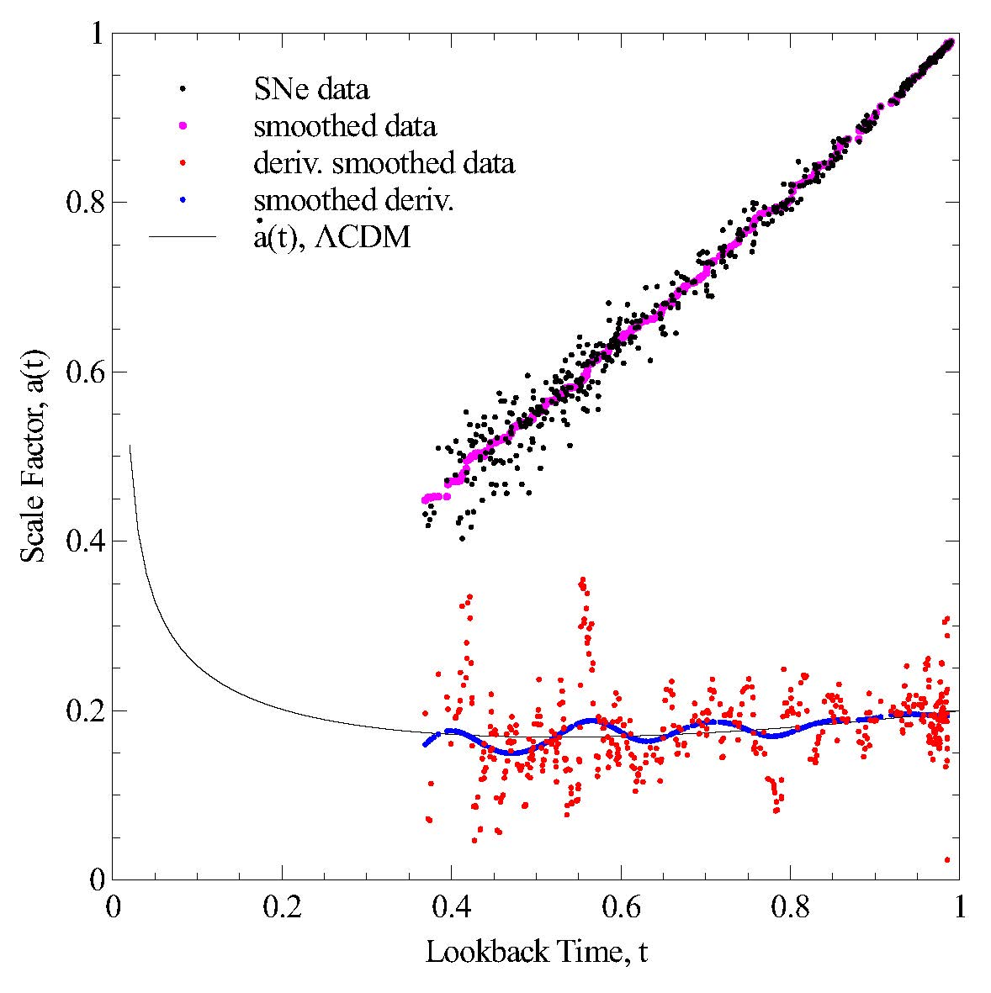
Oscillations in the Scale Factor
While searching for the “transition time” –the inflection point in a(t) – we found oscillations in the scale factor.
f = 6.5 ± 0.5 HHz
Subm. AJ, 2014

Slide 6
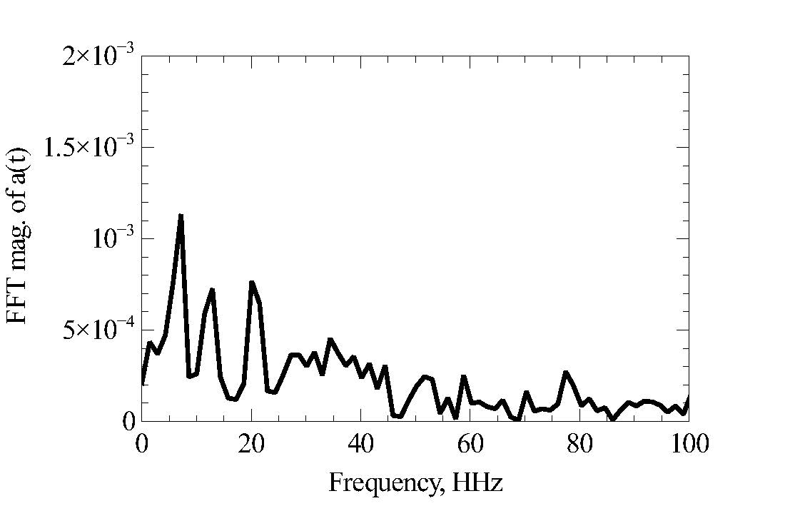
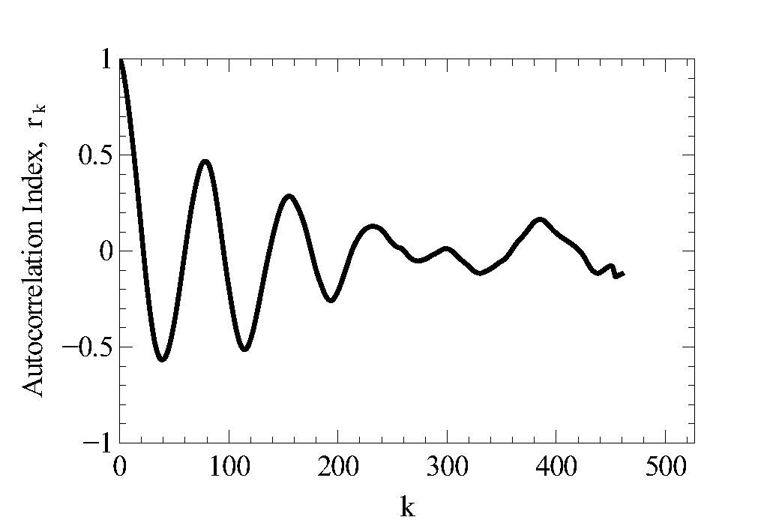
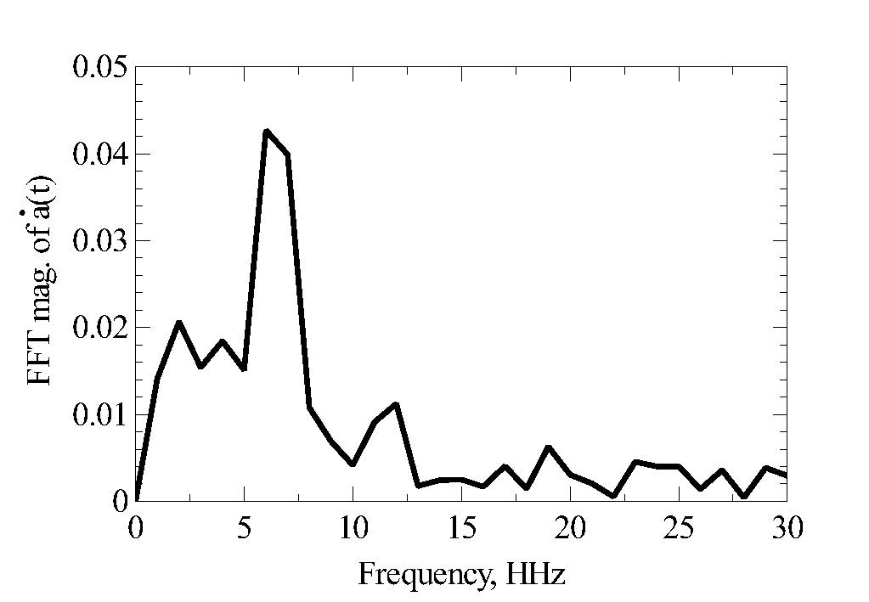
Evidence
Simple smoothing is inadequate evidence
FFT analysis
6.5, 13, 20 HHz
Autocorrelation
analysis - Strong
Improved SNR ~ 3

Slide 7
Scalar Field Dark Matter Model
“Chaotic Inflation – SHO ”
Scalar field is the dark matter

Slide 8
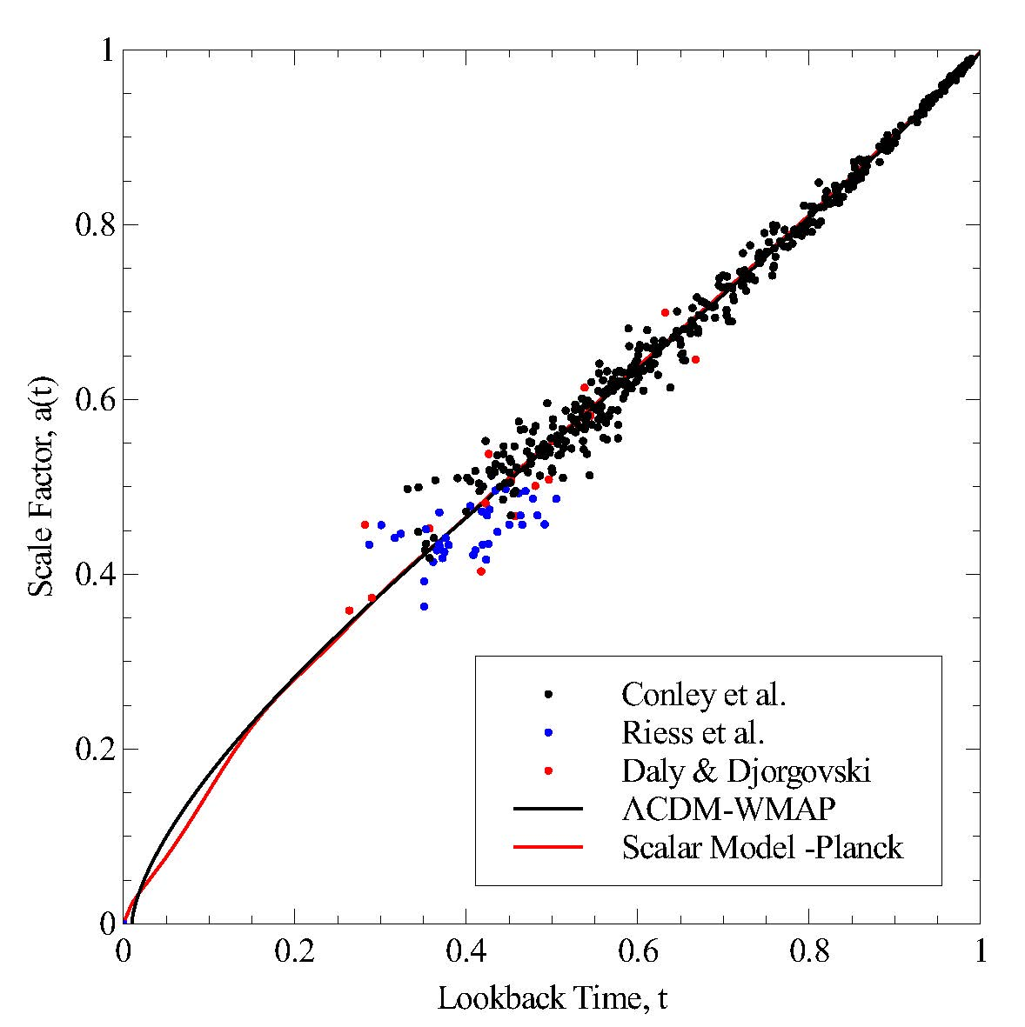
Scalar model a(t) Compared to ΛCDM

Slide 9
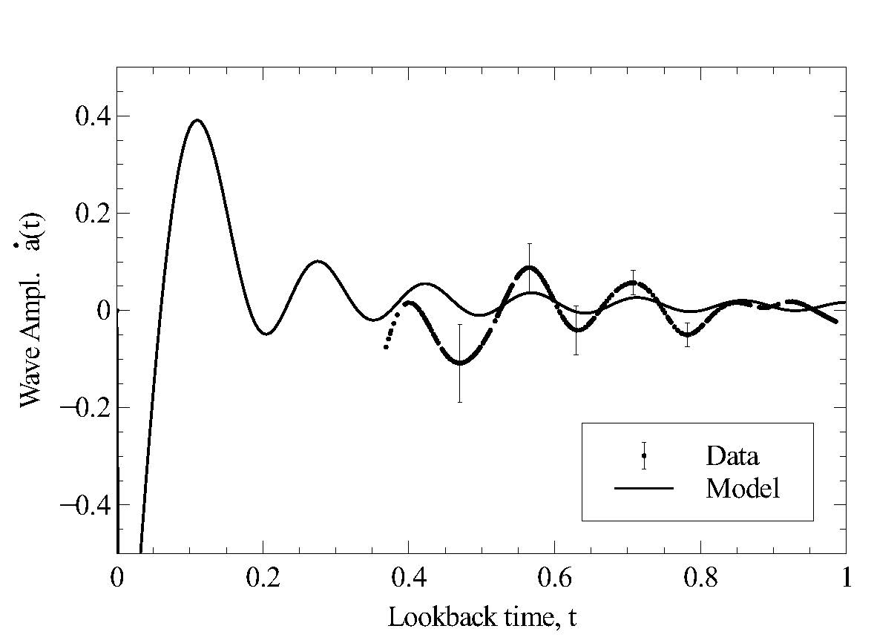
Data Signal Compared to Scalar Model
ΛCDM subtracted from

